Slide 1
Module #9:
Matrices
26年 11月 8日
©2001-2004 Michael P. Frank, revised by S. Kang

Slide 2
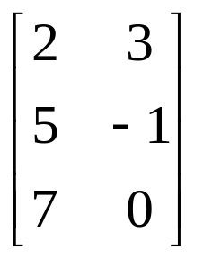
§2.7 Matrices
A matrix is a rectangular array of
objects (usually numbers).
An m×n (“m by n”) matrix has exactly m horizontal rows, and n vertical columns.
Plural of matrix = matrices
An n×n matrix is called a square matrix,
whose order or rank is n.
a 3×2 matrix
26年 11月 8日
©2001-2004 Michael P. Frank, revised by S. Kang

Slide 3
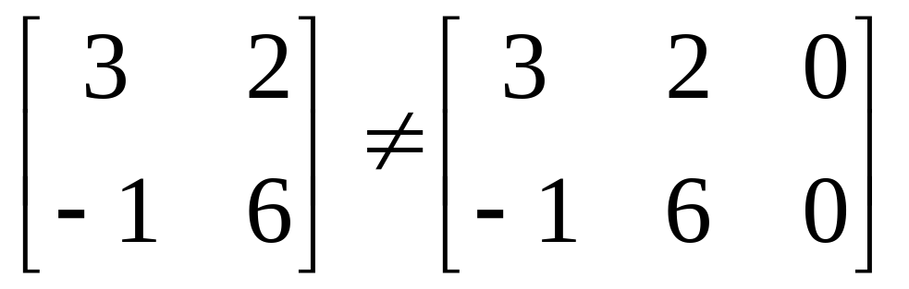
Matrix Equality
Two matrices A and B are considered equal iff they have the same number of rows, the same number of columns, and all their corresponding elements are equal.
26年 11月 8日
©2001-2004 Michael P. Frank, revised by S. Kang

Slide 4
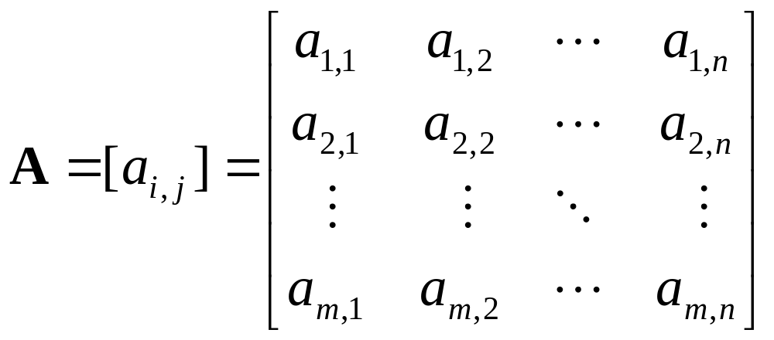
Row and Column Order
The rows in a matrix are usually indexed 1 to m from top to bottom. The columns are usually indexed 1 to n from left to right. Elements are indexed by row, then column.
26年 11月 8日
©2001-2004 Michael P. Frank, revised by S. Kang

Slide 5
Matrices as Functions
An m×n matrix A = [a_{i,j}] of members of a set S can be encoded as a partial function
f_{A}: N×N→S,
such that for i<m, j<n, f_{A}(i, j) = a_{i,j}.
By extending the domain over which f_{A} is defined, various types of infinite and/or multidimensional matrices can be obtained.
26年 11月 8日
©2001-2004 Michael P. Frank, revised by S. Kang

Slide 6
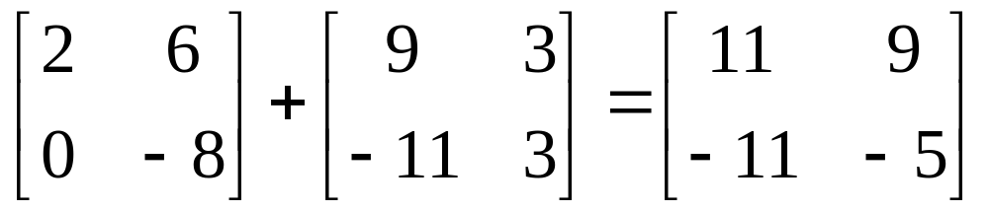
Matrix Sums
The sum A+B of two matrices A, B (which must have the same number of rows, and the same number of columns) is the matrix (also with the same shape) given by adding corresponding elements of A and B.
A+B = [a_{i,j}+b_{i,j}]
26年 11月 8日
©2001-2004 Michael P. Frank, revised by S. Kang

Slide 7
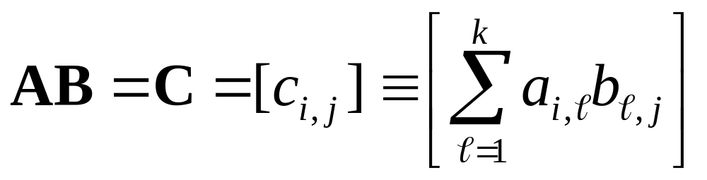
Matrix Products
For an m×k matrix A and a k×n matrix B, the product AB is the m×n matrix:
I.e., the element of AB indexed (i,j) is given by the vector dot product of the ith row of A and the jth column of B (considered as vectors).
Note: Matrix multiplication is not commutative!
26年 11月 8日
©2001-2004 Michael P. Frank, revised by S. Kang

Slide 8
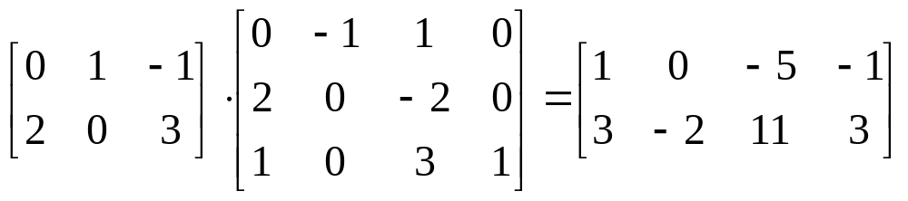
Matrix Product Example
An example matrix multiplication to practice in class:
26年 11月 8日
©2001-2004 Michael P. Frank, revised by S. Kang

Slide 9
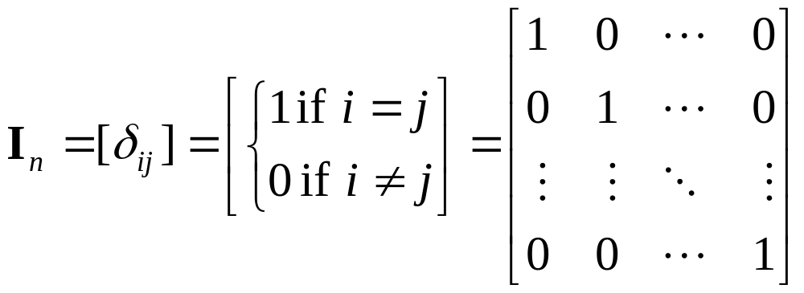
Identity Matrices
The identity matrix of order n, I_{n}, is the rank-n square matrix with 1’s along the upper-left to lower-right diagonal, and 0’s everywhere else.
∀1≤i,j≤n
n
Kronecker Delta
26年 11月 8日
©2001-2004 Michael P. Frank, revised by S. Kang
n

Slide 10
Matrix Inverses
For some (but not all) square matrices A, there exists a unique multiplicative inverse A⁻¹ of A, a matrix such that A⁻¹A = I_{n}.
If the inverse exists, it is unique, and
A⁻¹A = AA⁻¹.
We won’t go into the algorithms for matrix inversion...
26年 11月 8日
©2001-2004 Michael P. Frank, revised by S. Kang

Slide 11
Matrix Multiplication Algorithm
procedure matmul(matrices A: m×k, B: k×n)
for i := 1 to m
for j := 1 to n begin
c_{ij} := 0
for q := 1 to k
c_{ij} := c_{ij} + a_{iq}b_{qj}
end {C=[c_{ij}] is the product of A and B}
Θ(m)·
What’s the Θ of its
time complexity?
Θ(n)·(
Answer:
Θ(mnk)
Θ(1)+
Θ(k) ·
Θ(1))
26年 11月 8日
©2001-2004 Michael P. Frank, revised by S. Kang

Slide 12
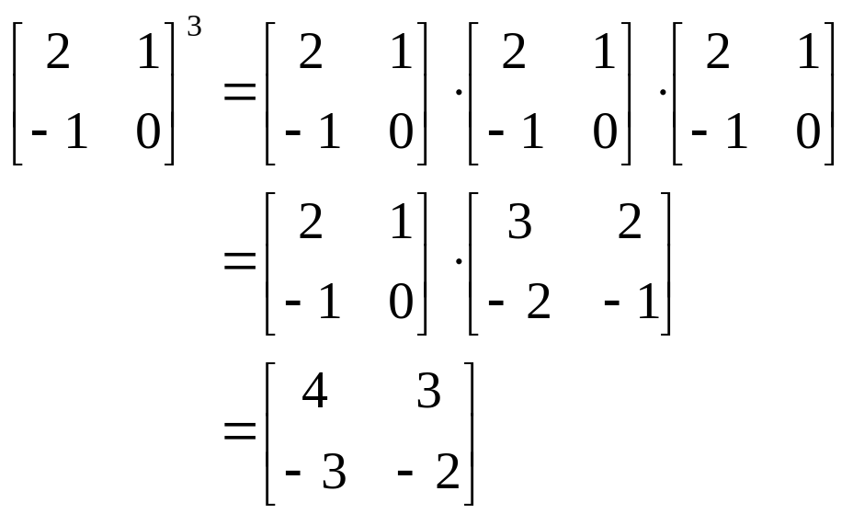
Powers of Matrices
If A is an n×n square matrix and p≥0, then:
A^{p} :≡ AAA···A (and A⁰ :≡ I_{n})
Example:
p times
26年 11月 8日
©2001-2004 Michael P. Frank, revised by S. Kang

Slide 13
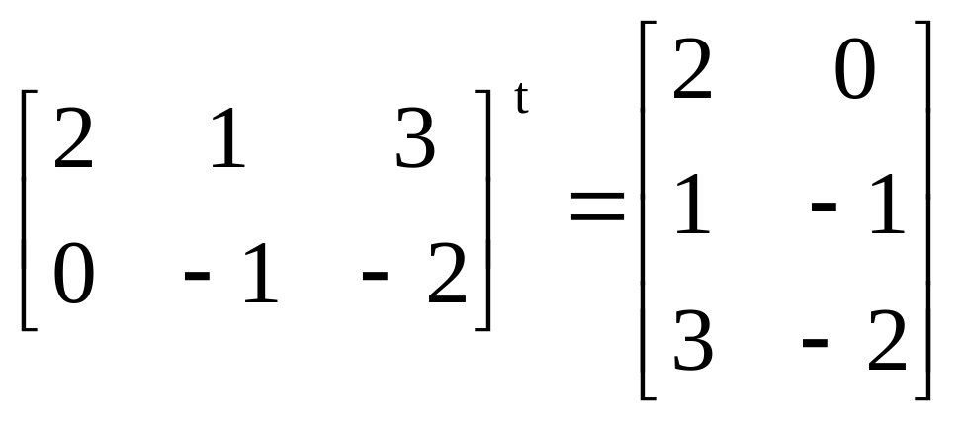
Matrix Transposition
If A=[a_{ij}] is an m×n matrix, the transpose of A (often written A^{t} or A^{T}) is the n×m matrix given by A^{t} = B = [b_{ij}] = [a_{ji}] (1≤i≤n,1≤j≤m)
Flip
across
diagonal
26年 11月 8日
©2001-2004 Michael P. Frank, revised by S. Kang

Slide 14
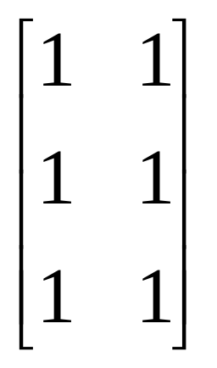
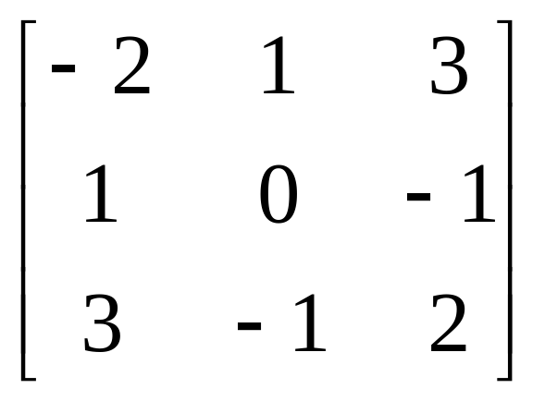
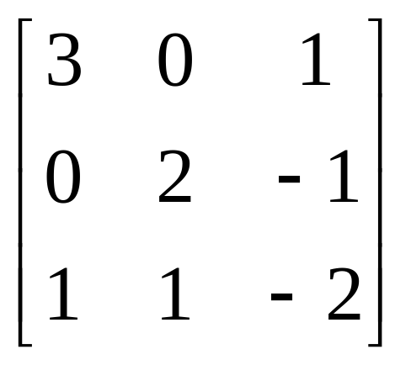
Symmetric Matrices
A square matrix A is symmetric iff A=A^{t}. I.e., ∀i,j≤n: a_{ij} = a_{ji} .
Which of the below matrices is symmetric?
26年 11月 8日
©2001-2004 Michael P. Frank, revised by S. Kang

Slide 15
Zero-One Matrices
Useful for representing other structures.
  E.g., relations, directed graphs
All elements of a zero-one matrix are either 0 or 1
  Representing False & True respectively.
The join of A, B (both m×n zero-one matrices):
  A∨B :≡ [a_{ij}∨b_{ij}]
The meet of A, B:
  A∧B :≡ [a_{ij}∧b_{ij}] = [a_{ij} b_{ij}]
26年 11月 8日
©2001-2004 Michael P. Frank, revised by S. Kang

Slide 16
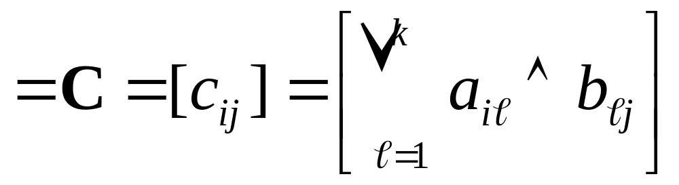
Boolean Products
Let A=[a_{ij}] be an m×k zero-one matrix,
& let B=[b_{ij}] be a k×n zero-one matrix,
The boolean product of A and B is like normal matrix ×, but using ∨ instead of + in the row-column “vector dot product”:
A⊙B
26年 11月 8日
©2001-2004 Michael P. Frank, revised by S. Kang

Slide 17
Boolean Powers
For a square zero-one matrix A, and any k≥0, the kth Boolean power of A is simply the Boolean product of k copies of A.
A^{[k]} :≡ A⊙A⊙ … ⊙A
A^{[0]} :≡ I_{n}
k times
26年 11月 8日
©2001-2004 Michael P. Frank, revised by S. Kang

